Slide 1
day one of retirement
Danie van Zyl

Slide 2
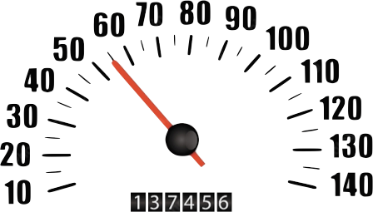
dad ... are we there yet?
distance
current speed
average speed
journey time
fuel consumption

Slide 3
day one ... retirement
pensioner perception
trustee perception

Slide 4
Benchmark 2013
pensioners
30%
believe enough capital last for rest of lives
34%
depleted lump sum at retirement
(just over half - 2 years)
trustees
participating employers
13.4%
members they estimate
will retire comfortably
17.9%
members they estimate
will retire comfortably

Slide 5
Benchmark 2013
pensioners
half
dropped in income (average 32%)
51%
shortfall between income and expenses
61%
unable to save

Slide 6
why?
day one employment

Slide 7
Benchmark 2013
brief introduction
retirement fund, risk benefits, medical forms etc.
1in10
did not receive retirement benefit form
1in5
no assistance from HR
1in5
given few hours to complete

Slide 8
Benchmark 2013
1in5
had difficulty filling in forms
1in3
did not have sufficient knowledge
9in10
of new employees never review their decisions

Slide 9
my ‘day one’ experience
I listened, nodded
and signed a form
‘
’

Slide 10
my ‘day one’ experience
I didn’t really get any advice ... I just had to tick the box
‘
’

Slide 11
my ‘day one’ experience
It was overboard on information
‘
’

Slide 12
day one - employment
targeted pension spelt out (not likely 5 years ago)
Benchmark 2013
of funds spell out targeted pension with employee (up from 35%)
41%
RR
mostly use replacement ratio

Slide 13
earn
investment
income
pay regular contributions
regular deductions

Slide 14
change
job
change
job
change
job
reach
retirement

Slide 15
contributions
Benchmark 2013
last 5 years
(average)
2013
employer
9.74%
9.96%
employee
5.87%
5.93%
total
15.61%
15.89%
union
non-union
total
14.31%
15.80%

Slide 16
deductions
Benchmark 2013
last 5 years
(average)
2013
group life
1.63%
1.68%
group disability
1.13%
1.22%
admin cost
big 0.50%
small 0.92%
administration
0.87%
1.01%
union
non-union
total deductions
2.81%
3.68%

Slide 17
net savings
Benchmark 2013
last 5 years
(average)
2013
net savings
11.98%
11.99%
lower than 2011 : 12.56% 2012 : 12.43%
union
non-union
net savings
11.49%
12.04%
small
big (non union)
net savings
12.5%
13.79%

Slide 18
net savings
11.98%
= 57.4% RR
or
= 9.7 x salary
x 40 years
is this
enough?
... assumes full preservation and no 1/3 lump sum!

Slide 19
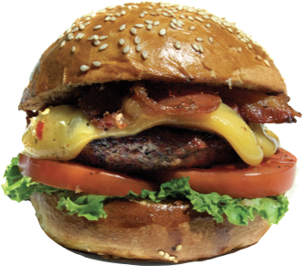
SURVIVAL
not a burden on family
what should we aim for?
what’s comfortable?
STATUS QUO
retain current standard
TRAVEL
financial freedom

Slide 20
how much?
Benchmark 2013
replacement ratio (RR) stats (PO)
monthly income before retirement
R10K
-R25K
<R10K
R25K+
RR considered necessary for survival
58%
62%
61%
RR considered necessary to maintain current living standard
RR considered necessary to live beyond current living standard

Slide 21
how much?
Benchmark 2013
replacement ratio (RR) stats (PO)
monthly income before retirement
R10K
-R25K
<R10K
R25K+
RR considered necessary for survival
average 60%
RR considered necessary to maintain current living standard
74%
72%
76%
RR considered necessary to live beyond current living standard

Slide 22
how much?
Benchmark 2013
replacement ratio (RR) stats (PO)
monthly income before retirement
R10K
-R25K
<R10K
R25K+
RR considered necessary for survival
average 60%
RR considered necessary to maintain current living standard
average 75%
RR considered necessary to live beyond current living standard
87%
88%
87%

Slide 23
how much?
Benchmark 2013
replacement ratio (RR) stats Pensioners
monthly income before retirement
<R10K
R10K+
RR considered necessary for survival
52%
63%
RR considered necessary to maintain current living standard
68%
79%

Slide 24
how much?
Benchmark 2013
funds with replacement ratio target
average
70%
14.6%
x 40 years

Slide 25
do members understand?
what
salary
needed?
10.7
times
RR?
R
easier?
pensioner
should be closer to 12 times

Slide 26
rough rule of thumb
40 years
12 times
milestones for saving to achieve 70% RR
7 times
30 years
20 years
4 times
after 10 years
2 times

Slide 27
what members need ...
14.6%
40
CPI 5.5%
x
x
+
net contribution
years
investment returns

Slide 28
to guide members ...
essential defaults
preservation (40 years)
contribution (14.6%)
investment choice (CPI +5.5%)

Slide 29
default options ...
will it make a difference?
most appropriate solution for the majority
institutional (not retail) fees - for admin / investment
potential for “near seamless” transfers
contribution
preservation
investment choice

Slide 30
income
stack odds in members favour
sufficient lump sum at retirement
retire
lump sum

Slide 31
day one ... retirement
financial + psychological hurdle
big decisions
TRUSTEES
guided them this far

Slide 32
annuities
Benchmark 2013
77%
provide pre-retirement counselling (4.3yrs before)
76%
concerned how members utilise their retirement benefits
76%
do not want further involvement with members after retirement

Slide 33
annuities
Benchmark 2013
most appropriate? ... inflation linked
20%
already have default annuity

Slide 34
markets volatility ...
timing risk
sequence risk
7%
27%
7%
-15%
7%
9%
7%
7%

Slide 35
sequence of returns
portfolio value
7%
7%
7%
7%

Slide 36
sequence of returns
portfolio value
27%
-15%
9%
7%

Slide 37
planning ...
depends how you frame the question?
income stream?
bequest?
secure income stream, increasing
with inflation
live off volatile
investment returns

Slide 38
planning ...
depends how you frame the question?
income stream?
bequest?
secure income stream, increasing
with inflation
flexibility: how assets are invested, retain control of assets on death

Slide 39
annuities
Benchmark 2013
82%
of pensioners want certainty ... guaranteed income
18%
would accept risk (50:50 5% higher / 5% lower)

Slide 40
day one ... retirement
defaults
save more – but need clear aim
review - check milestones
... are we there yet?
starts day one ... employment

